Slide 1
Are we ready for Quantum Internet?
Dr Romerson Oliveira High Performance Networks Group | Smart Internet Lab
29th November 2022

Slide 2
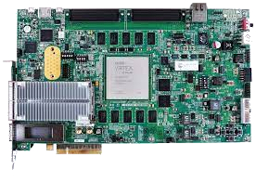
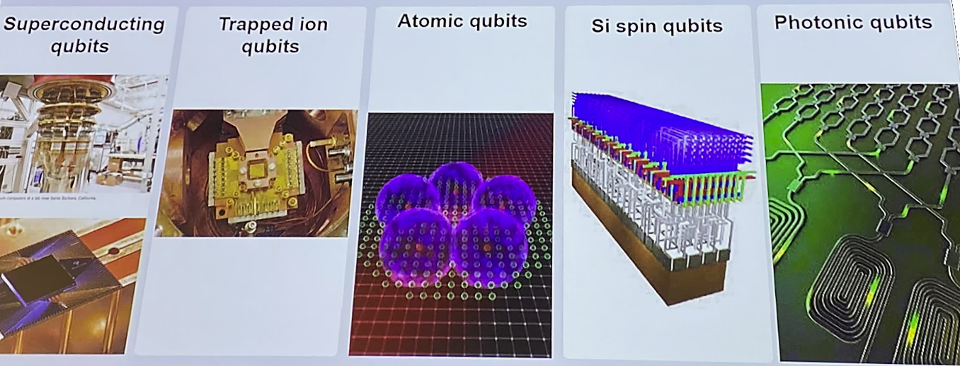
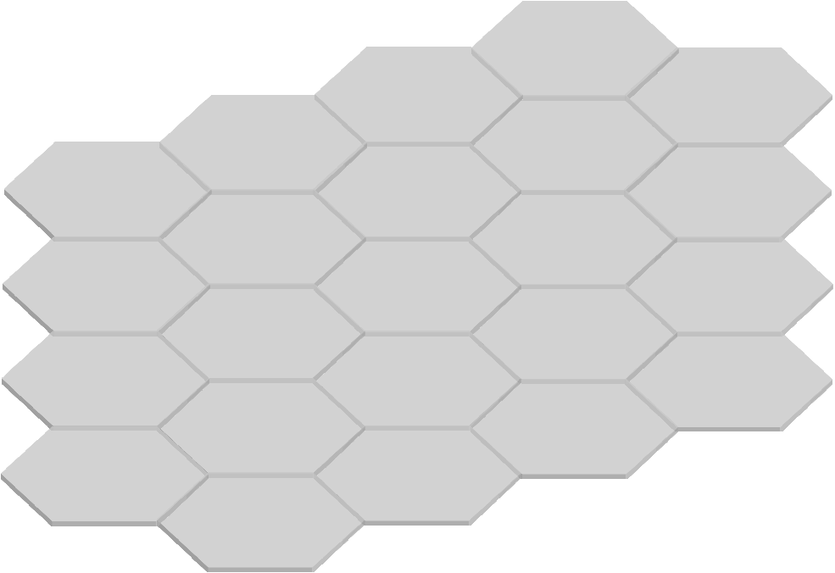
The Quantum Internet
Quantum Network
Control & Management
Programmable Hardware
encryptor
Q-node
QFC
QPU
Quantum Key Distribution
QPU
QFC
secret data
Q-node
10GE – 100GE
User
Application
Distributed Quantum Computing
What about the sociotechnical impact of our research?
Network
Control&Mgmt
Secure sensitive data;
Bring QKD closer to end user;
We are working towards a society being prepared for broad, affordable and equitable access to the quantum internet;
Key
Management
sync & processing
Key
Generation

