Slide 1
Digital Twins Security of Digital Twins for security through Digital Twins
Rasheed Hussain
29-11-2022

Slide 2
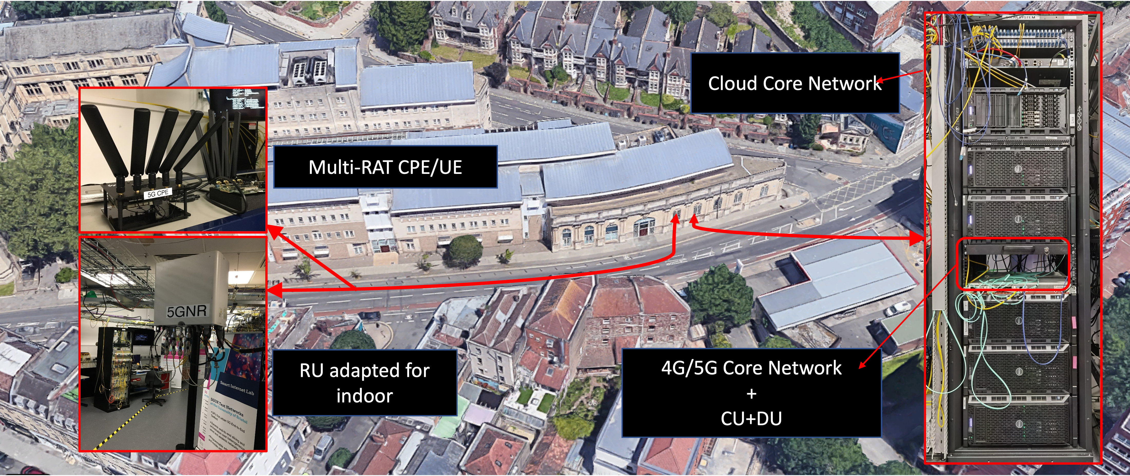
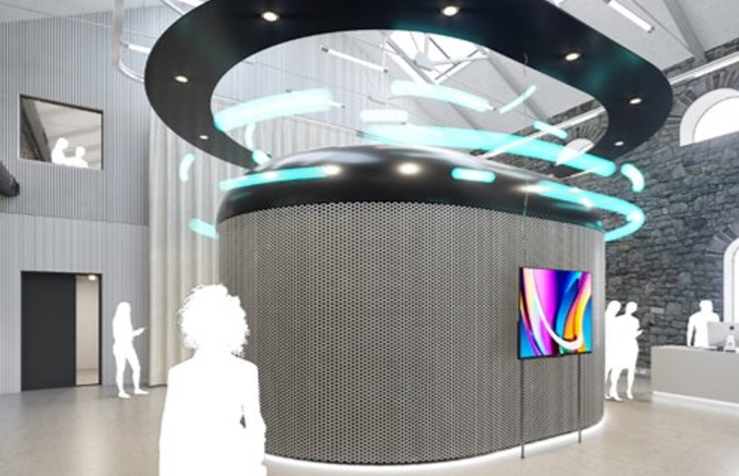
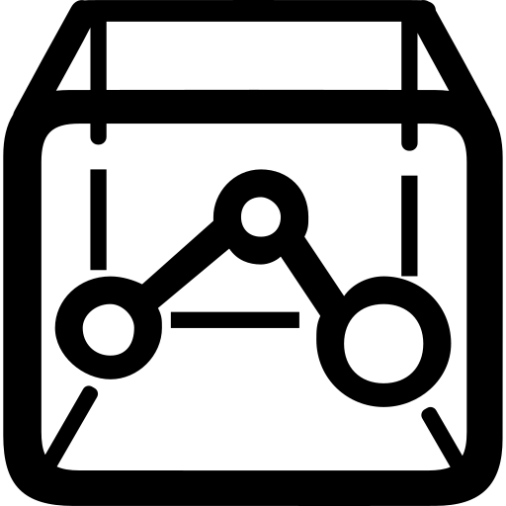
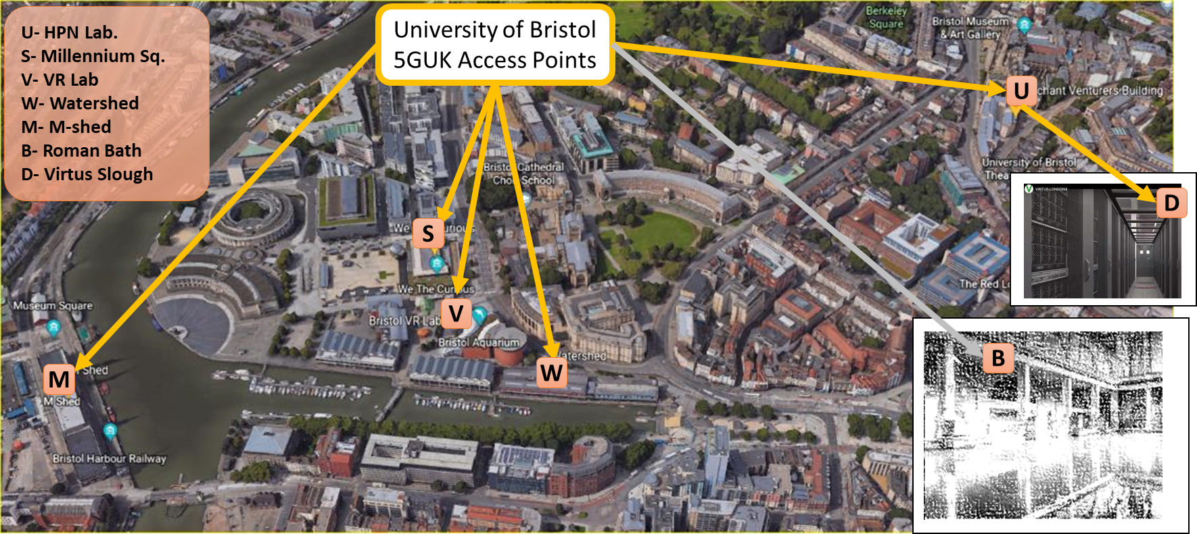
Security of Digital Twins AND Security through Digital Twins
Smart Internet Lab
Reality Emulator (RE) at Bristol Digital Futures Institute
BDFI Data Centre
Physical assets (testbeds)
Modeling
Digital model
Immersive experiences
Network infrastructure
IoT Platforms
Fibre and Radio assets
Cloud and MEC
Packet cores
Mapping/translation of security aspects of physical to DT environment
Trustworthy DT environment (secure replication and state synchronization)
Security of DT
Threat intelligence, attack detection, and mitigation
Cybersecurity awareness and learning through cyber range and gamification
Cyber deception and moving target defense
Securing infra.
through DT

