Slide 1
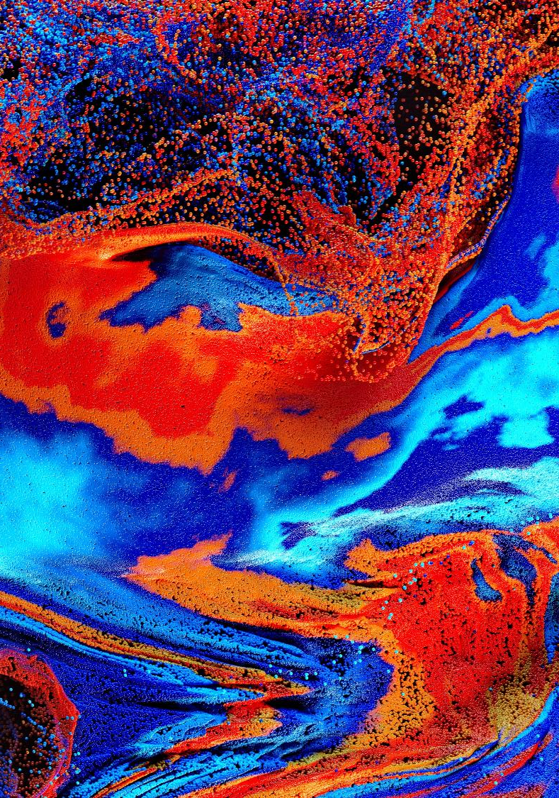
Reality Emulator
Professor Dimitra Simeonidou
Academic Co-Director
BDFI

Slide 2
Our Digital Futures
Devices are becoming the main users of the network
By 2030 the number of internet connected devices will reach 500B - 59 x more than the predicted world population
What will be the role of humans in the future digital service delivery chain?
Co-creation of digital technologies and services with the end users
Collective Intelligence = human + machines + infrastructure
Sociotechnical principles and social practices, behavioral science, neuroscience, as the foundations for responsible innovation, security, sustainability, inclusion, privacy, trust…
Network-Centric: Internet
Device-Centric: 5G
Human-Centric?
Notes:
I don’t think we should be using images of our staff for the slides! Do we have another we can use?

Slide 3
The Future: A cyber-physical continuum
More devices, much more data, richer experiences and in particular immersive multi-sensory experiences and digital twins of future systems.
More people will spend even more of their lives immersed in virtual worlds that will become in many respects indistinguishable to the physical world.
For example, the next generation of mobile networks (Next G) seem likely to be driven by a set of expectations of the immersive living, cyber-physical convergence, Internet of Senses.
This will not be an application that runs on top of existing infrastructure. It’s the next iteration of digital infrastructure that supports real-time experiences
Delivering such future will require step-change innovations in infrastructure architectures and underlying technologies
Notes:
I don’t think we should be using images of our staff for the slides! Do we have another we can use?

Slide 4
The Future: A cyber-physical continuum
Human-Centric
Models
The physical world of digital connectivity, sensing, data and real world experiences
Physical World
Digital World
Digital representation of physical world scenarios
Real Time
Programmable
Intelligent
Iterative
Notes:
I don’t think we should be using images of our staff for the slides! Do we have another we can use?

Slide 5
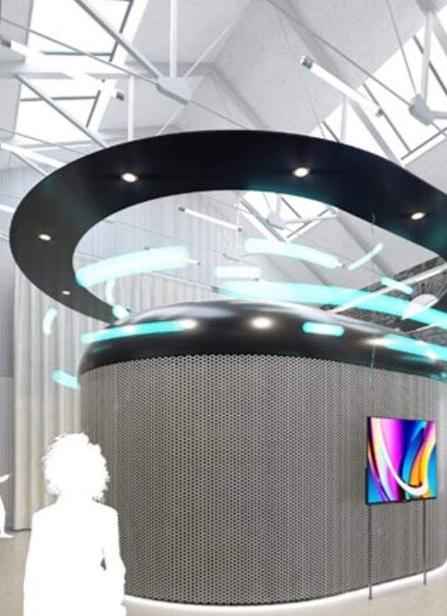
The Reality Emulator
Collaborative and inclusive
Multisensory
Technologically advanced
Driving digital innovation for the future

Slide 6
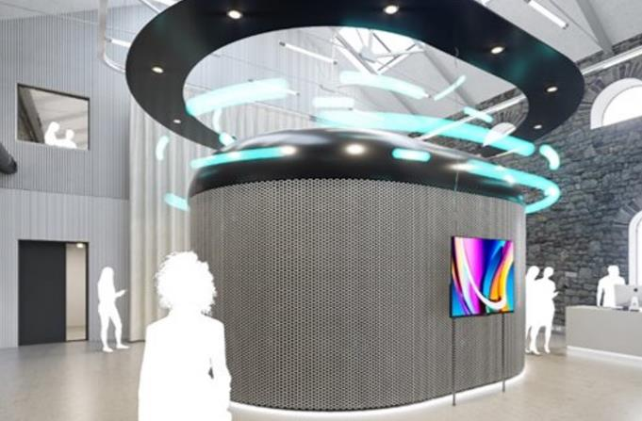
An advanced digital twin for futures research
Collaboratory: Applications, Solutions, Functions, Policies, Regulation
Energy Substation, Renewable Energy Batteries, Energy Monitoring/Management
Physical Testbeds/Pilots
Virtual production
Digital model
Immersive experiences
Data Analysis/Scaling
AI/ML, training
Software-Hardware co-design
Security
Protocol Design
6G Emulation
Scenarios’ creation
Laboratories
Fibre and Radio assets
IoT Platforms
Cloud and MEC
Cities, transport, factories etc.
DC, Cloud
Data Platforms
Programmable Hardware
Optical Interconnect/Switching
Hosting Research Hardware: New Fibre, Neuromorphic, Quantum…
Continuous, iterative evolution and optimization
(pre-trained ML models)
Multi-user
Multi-purpose
Interactive
Multisensory

Slide 7
Multiple use cases
Media, gaming , collaborative creative arts
Multisensory XR experiences
Industry 5.0
City planning
Our rail station (Temple Meads)
Education and training
The future of health
Connected robotics and autonomous systems including transport
Tourism
The future of work
Commerce in the virtual world
…
Notes:
I don’t think we should be using images of our staff for the slides! Do we have another we can use?

Slide 8
Desired outcomes
A dynamic digital twin with synchronous real-time updates
Co-design, co-creation methodologies
Improved cooperation and interaction
Convergence architectures for sensing, computing, energy and communications
Cyber security threat landscape– with insights on how this conceptualization changes depending on the architectures and technologies involved
Carbon emissions management
New business opportunities and models
Policy, regulation, standards
Notes:
I don’t think we should be using images of our staff for the slides! Do we have another we can use?

Slide 9
Breakout
What use cases or research studies could you imagine for the Reality Emulator?
20 minutes
1 sentence report back

