Slide 1
Neutral Lab
Professor Susan Halford
Academic Co-Director
BDFI

Slide 2
What is the Neutral Lab?
A unique space for exploring, imagining and making sociotechnical futures, together
A completely flexible co-creation space, packed with resources
An evolving, experimental community
A research project!
bristol.ac.uk/digital-futures
Notes:
I don’t think we should be using images of our staff for the slides! Do we have another we can use?

Slide 3
What’s the opportunity?
Over the next few months:​
Period of co-design​
Bring the space alive with your collaborative ideas​
Help us test and experiment​
Think about opportunities, support and challenges​
Build the community as we develop​
bristol.ac.uk/digital-futures

Slide 4
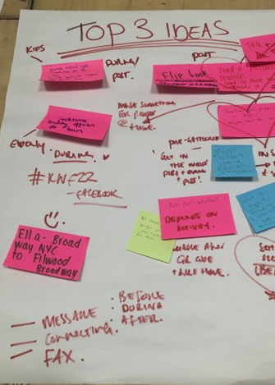
What can you expect?
Accessible, inclusive and shared environment
Support from members of BDFI
Help to bring new teams together and facilitate existing collaborations
Clear guidance and training on using the facilities
Creative and digital resources in The Cupboard
Membership of a community of users that adds value to your work
bristol.ac.uk/digital-futures

Slide 5
What we ask
Focus on sustainable, prosperous and inclusive digital futures
Be open, curious & collaborative
Interact with other residents
Contribute to the Neutral Lab:
Be present in the space
Help shape and develop the community
Feed into our ongoing research
Share what you do
bristol.ac.uk/digital-futures

Slide 6
Watch this space
Collaborative, creative workshops to support your work on digital futures
Expression of Interest to be a pilot resident
BDFI Seed Corn funding call, which could include a pilot residency
bristol.ac.uk/digital-futures

Slide 7
Breakout
1. Discuss your ideas for a NL residency
2. Tell us your requirements of the NL
3. Explore what research is happening in this space
4. Find out about the residency application process and timelines
5. Help us curate the ethos and values of the space
bristol.ac.uk/digital-futures

