Slide 1
Bristol Digital Futures Institute Partner Open House
@digifutures
Notes:
Susan Halford – Co-Director of Centre for SocioDigital Futures, Dimitra – Director of Smart Internet Lab

Slide 2
Welcome
@digifutures
Professor Susan Halford and Professor Dimitra Simeonidou
Academic Co-Directors, BDFI
@digifutures

Slide 3
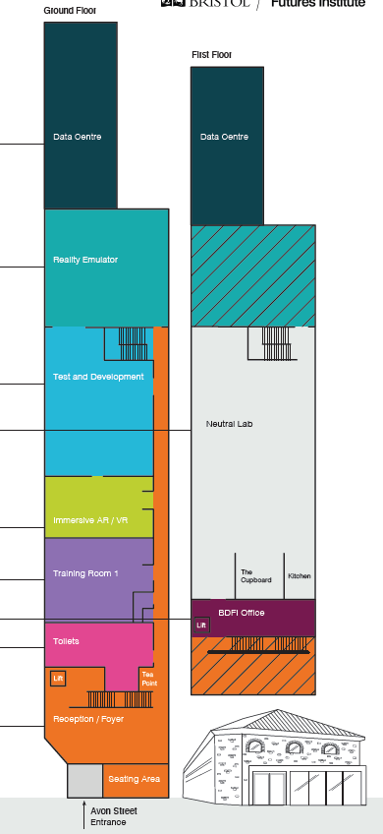
Agenda
Time | Activity
12.00 | Arrival, lunch and networking
12.45 | Welcome address
13.05 | Reflections
13.15 | Discussion
13.30 | Break
13.50 | Introducing the Neutral Lab
14.40 | Introducing the Reality Emulator
15.25 | Break
15.40 | Flash presentations
16.00 | Demonstrations and networking
16.50 | Closing remarks
17.00 | MyWorld MEETS Networking Event

Slide 4
Introduction to BDFI
BDFI is a University Research Institute that pioneers transformative approaches to digital innovation. BDFI is developing in-depth and systematic understanding of sociotechnical futures to drive the creation of digital technologies for inclusive, prosperous and sustainable societies.
Established in September 2019
Directors: Prof. Susan Halford (Social Sciences), Prof. Dimitra Simeonidou (Engineering)
Integrating expertise across the University’s Faculties
With partners from industry, government and civil society
Initial funding £100m co-investment by Research England and BDFI partners, plus additional University and philanthropic funding
Located in the Temple Quarter Enterprise Campus
Notes:
(Hayley’s notes) SH – ad-lib a v brief tie into whatever Tom Roden says, as possible; welcome old friends and new – short presentation provide brief background information for those who are new to BDFI; update on our progress building BDFI capabilities; set the scene for today, building on the

Slide 5
Why BDFI?
We live in sociotechnical world
This is changing our lives, for better and for worse.
We know this from looking at the past & the present.
How do we shape the future?
bristol.ac.uk/digital-futures
Notes:
SH

Slide 6
Disrupting digital innovation
We need new ways of thinking about (and doing) innovation – as sociotechnical
By creating new technologies with sociotechnical methodologies, we can create futures that are more prosperous, inclusive and sustainable.
This demands new ways of working
across disciplines
with partners from all sectors
with new facilities and spaces…
to support this ecosystem, develop new methodologies and create technologies of the future.
bristol.ac.uk/digital-futures
Notes:
SH

Slide 7
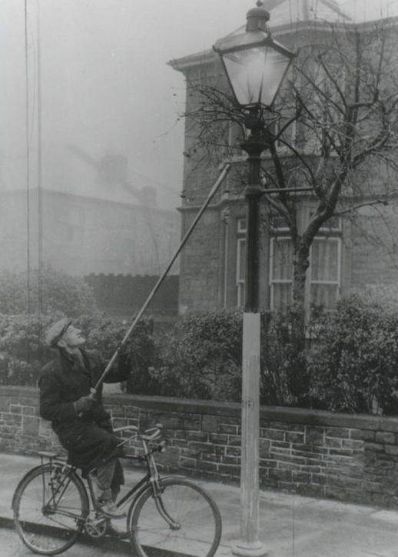
Building the foundations
£29m capital
Former headquarters of the Bristol Gas Light Company​
Brought technical innovation to Bristol in the form of gas lighting​
Delivered social, cultural and economic benefits (night-time economy, changed concepts of time), but also social and environmental costs. ​
Throughout the history of the site, technical change and social change have been bound together in ways that have shaped the lives of local people as well as the economy and environment of Bristol. ​
As stewards of the site, we want to learn from those histories and drive future industrial revolutions through our breakthrough sociotechnical approach to innovation.​
Notes:
DS

Slide 8
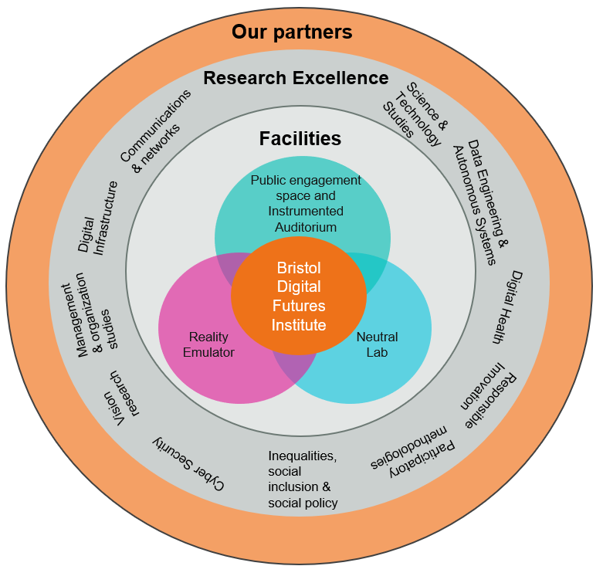
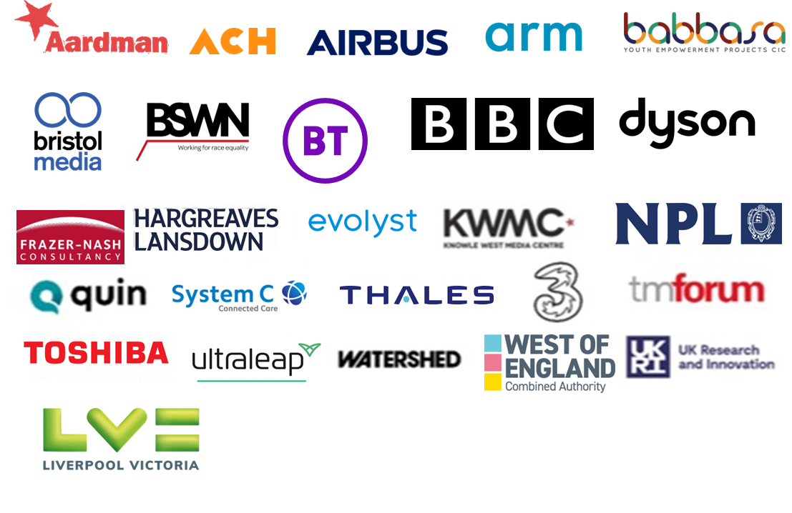
Delivery at scale
£29m capital £100m programme 28 partners
bristol.ac.uk/digital-futures
Notes:
DS

Slide 9
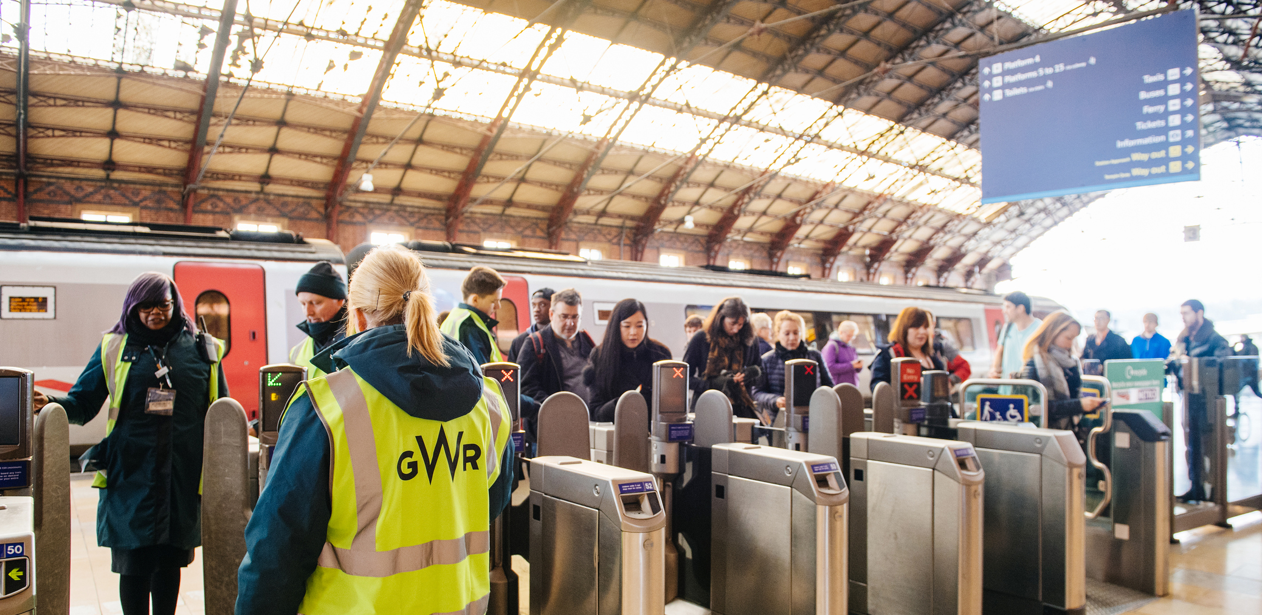
Projects in progress
Net Zero Sustainable Campus Testbed
Infrastructures, content and security in the metaverse
UK Telecom Innovation Network
Station Innovation Zone at Bristol Temple Meads

Slide 10
Projects in progress
Centre for Sociodigital Futures
Explainable AI
Connecting through culture as we age
Centre for Gambling Harms Research

Slide 11
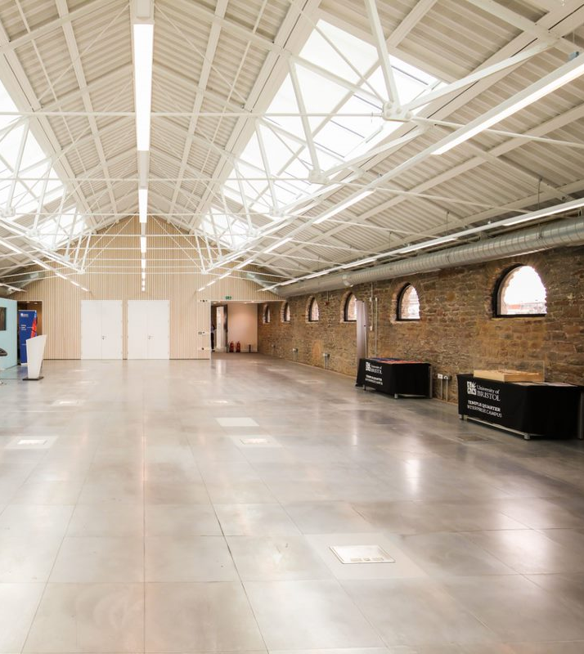
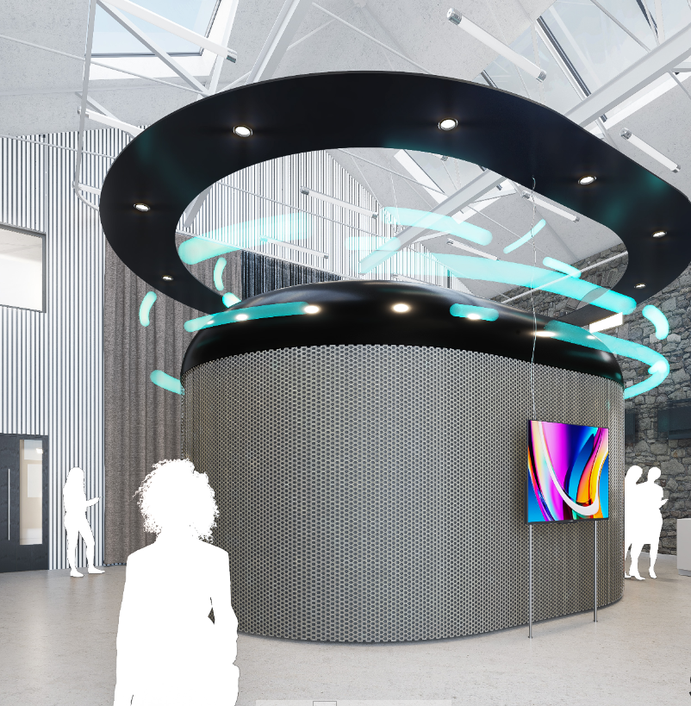
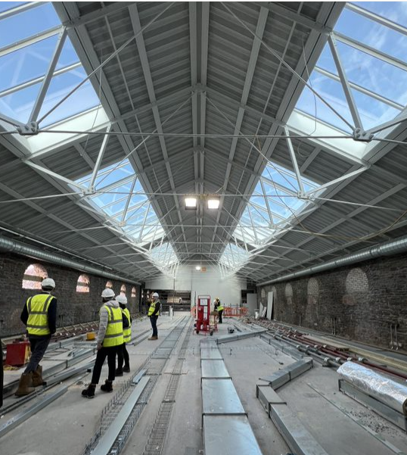
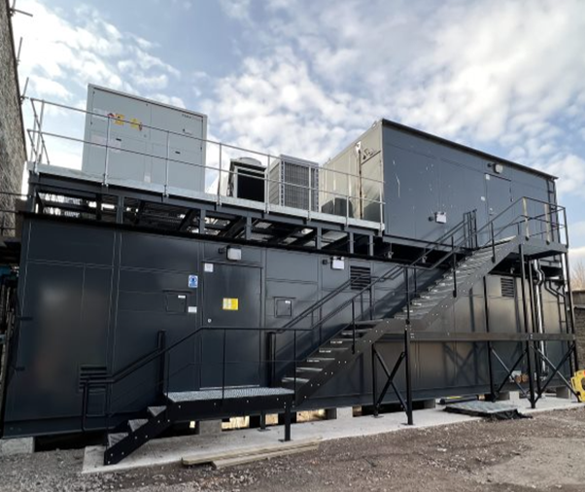
Building the Foundations: Facilities Phase 1
Neutral Lab Data Centre Reality Emulator
+ Cyber Suite
Phase 1 - Retort House opened 2022

Slide 12
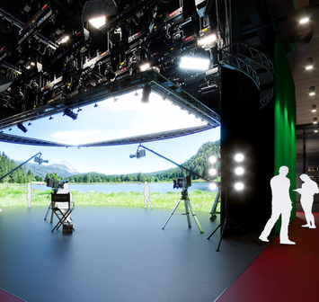
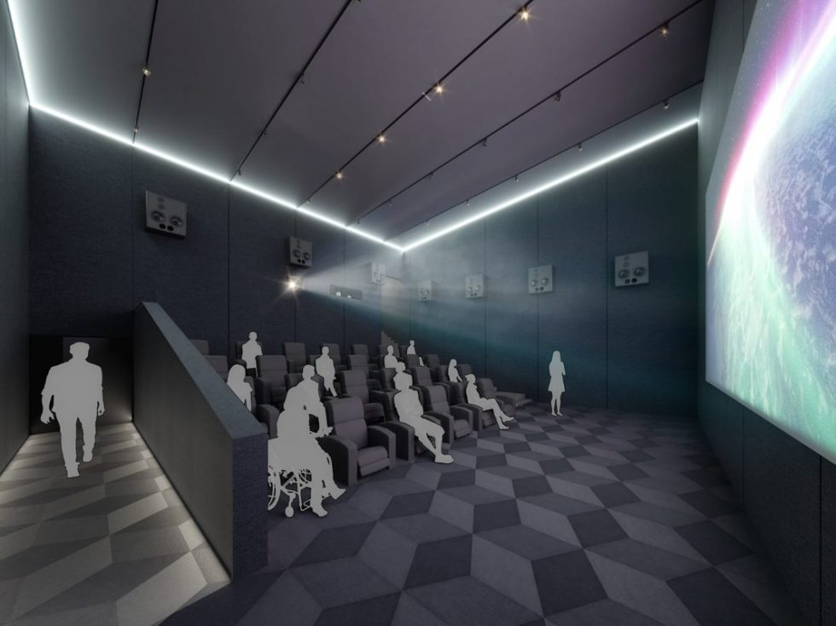
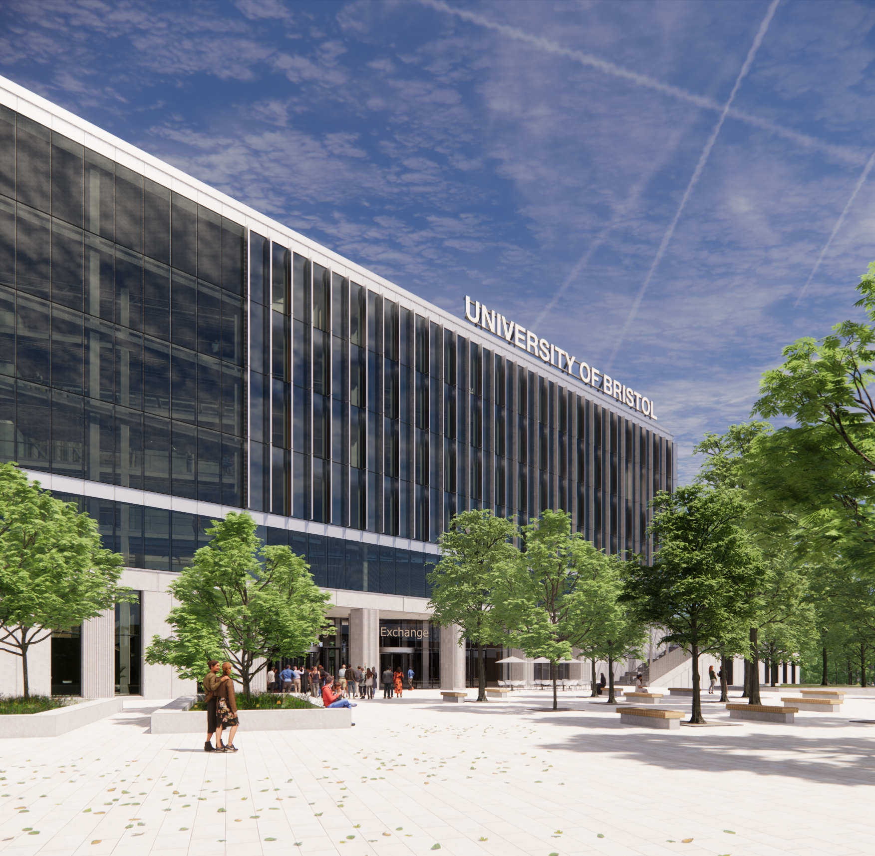
Building the Foundations: Facilities Phases 2 & 3
Creative Continuum Spaces
Instrumented Auditorium
Digital Health Node + additional facilities
Phase 2 - Coal Shed ready 2023-24
Phase 3 - CM1 2026

Slide 13
Questions?

Slide 14
Reflections
Professor Tim Whitley
BT

Slide 15
Discussion
5 minutes with your neighbour
What does sociotechnical innovation mean to you?
How does it feature in your organisation/ work?

