Slide 1
Explainable AI Decision Making
Dr Marisela Gutierrez Lopez
Senior Research Associate
BDFI & SPAIS

Slide 2
Explainable AI project
What makes AI explainable from a sociotechnical perspective?
Innovative methods and collaboration to reimagine Explainable AI with civic and commercial partners

Slide 3
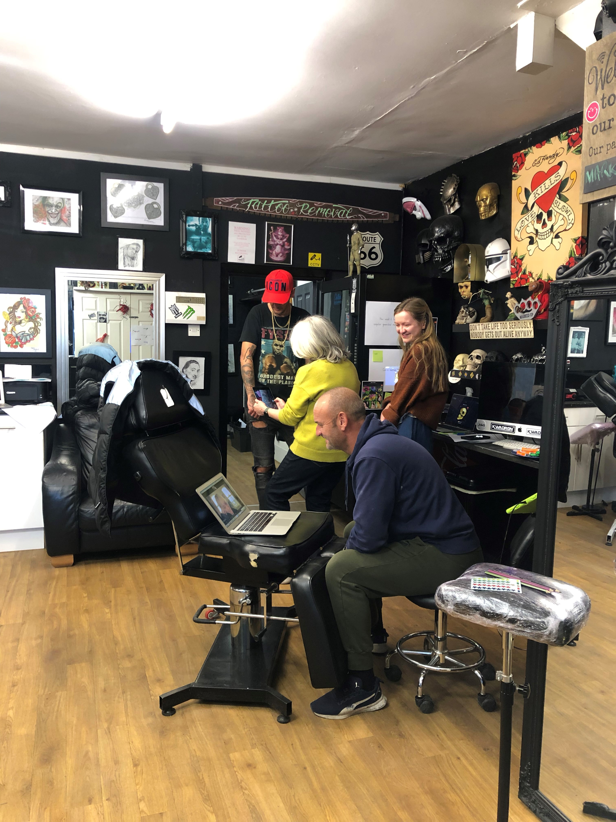
Project impact
Integrating research into LV=GI processes and best practices
Delivering tangible benefits to communities in Bristol
Widening the horizon of sociotechnical research and innovation

