Slide 1
Nomadic Node 5G in a Box
Dr Hamid Falaki
Smart Internet Lab
29th November 2022
Bristol Digital Futures Institute Partners Open House

Slide 2
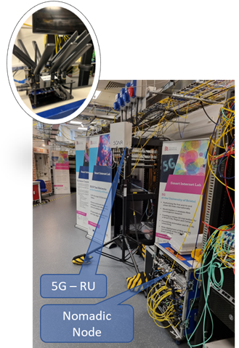
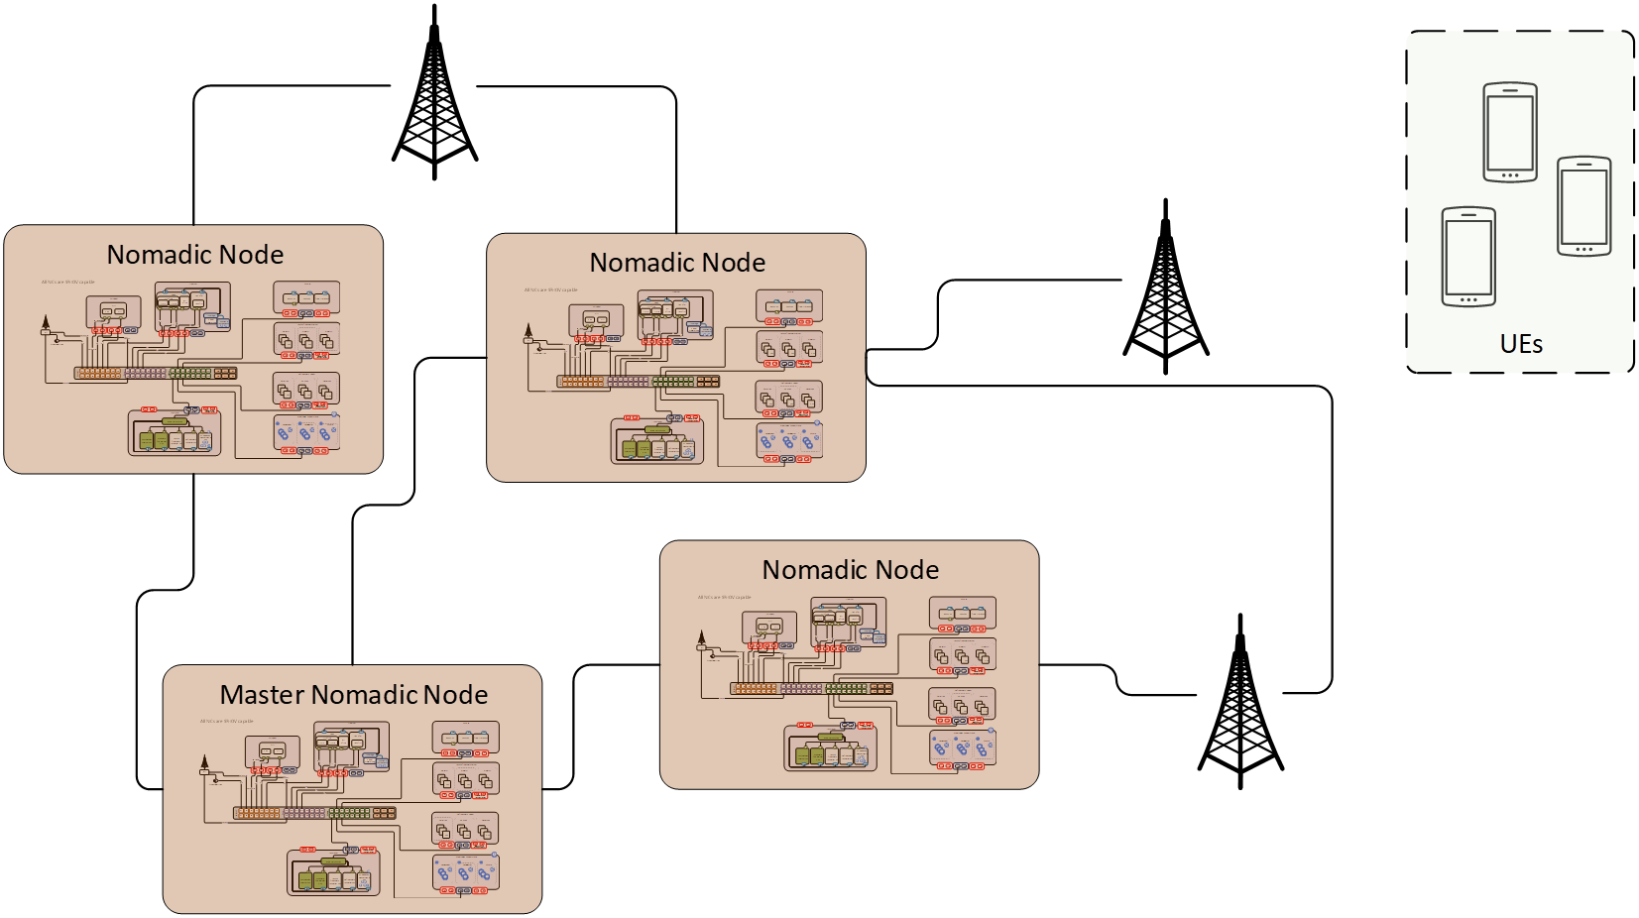
Nomadic Node – 5G in a Box
Provides opportunity to:
Democratisation of technology and network innovation
Demonstrate open platforms that can support innovation across layers
Enable various sectors to innovate on technology and business models
Accelerate technology translation and adoption
Field Trials
Air
Zeus & Hermes
Water
Fully Autonomous
Land
Backhaul to Data Centre with various options
Many Business & Industrial Applications
Notes:
Nomadic Node – 5G in a Box is a standalone network entity.
This portable 5G in a box solution has the capability to create multiple cell coverage areas using 4G, 5G, WiFi or LiFi technologies in Standalone mode for enhanced mobile broadband applications and services.
This solution provides improved broadband and IoT platform connectivity as well as ultra-low latency configurations for blind spot coverage.
Designed for rapid development of the sub-systems within or in operation with an Open RAN and Open Core networks architecture.
Provides opportunity to:
Evaluate business solutions
Develop various network functions
Experiment with Multi-access Edge Computing (MEC) applications
Develop Orchestration and network data platform for machine learning
Explore artificial intelligent developments & deployments
Research & Experiment with disaggregated 4G/5G Core and RAN networks
Research & Experiment with flexible backhaul network connectivity
In Summary, Provides opportunity to:
Democratisation of technology and network innovation
Demonstrate open platforms that can support innovation across layers
Enable sectors to innovate on technology and business models
Accelerate technology translation and adoption
This platform Consists of -
WEB API for Network Management
Service Management & Orchestration
End to End Communication
Virtualised Infrastructure
Edge Computing for Applications
5G SA Core Network
4G / 5G / WiFi / LiFi Radio Access Network
Multi-Access CPE as Modem or UE (4G / 5G / WiFi / LiFi)
WAN towards Data Centre
LAN within for X-haul & Data Breakout

